Slide 1
**** Building a Network ****
Lesson 2.2

Slide 2
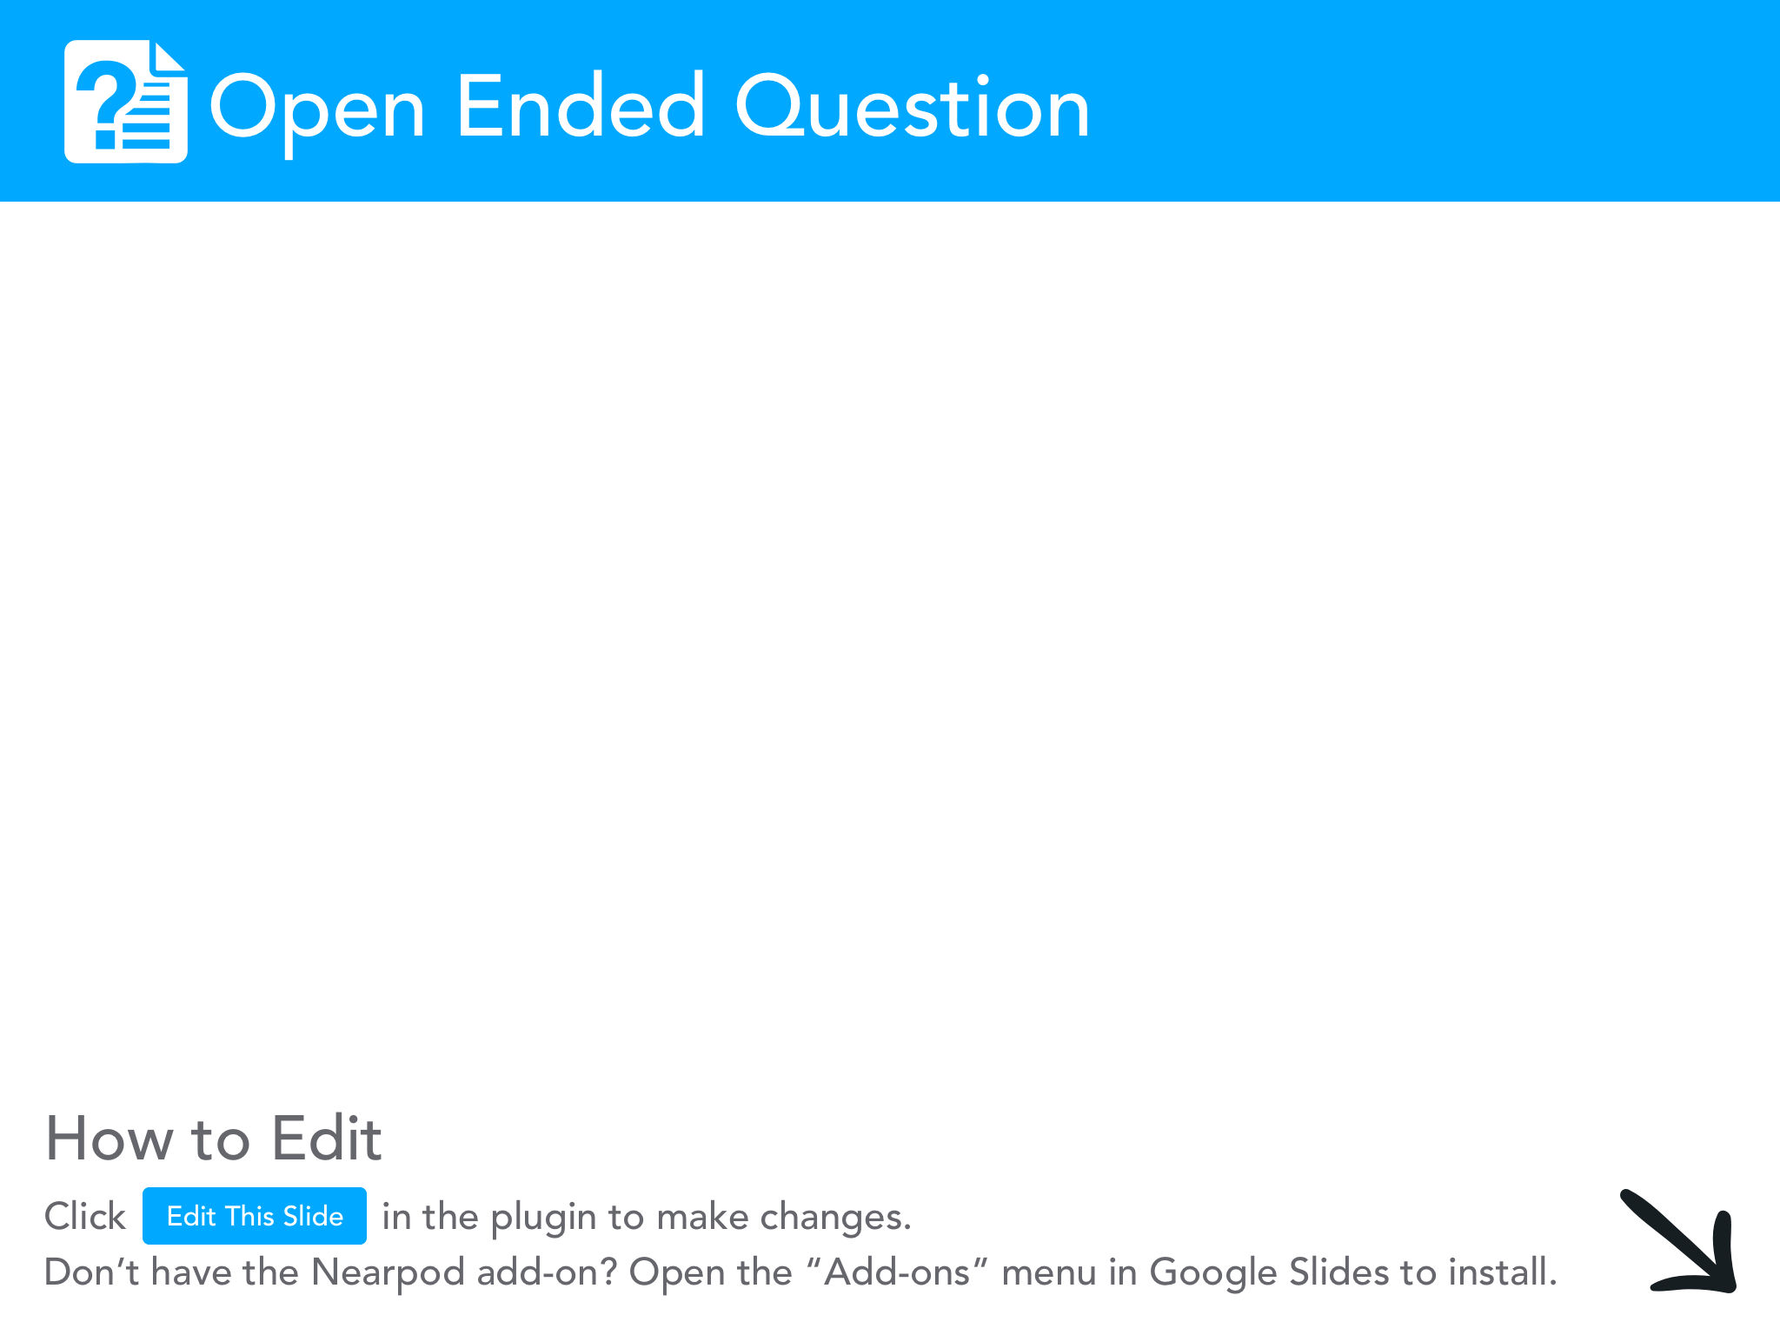
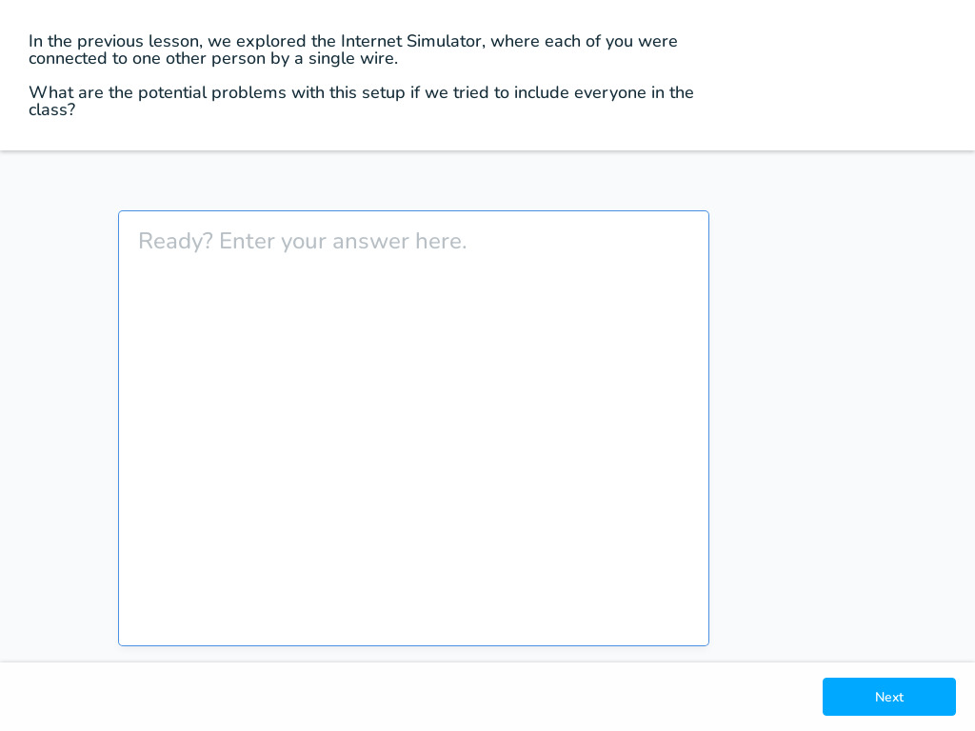

Slide 3
Building a Network
We are going to build a computer network that will let us communicate with multiple people. We will be drawing lines to represent our connections - if two people are connected with a line, then they are allowed to speak to each other. Only two people can be connected by a single line, but you can be connected to multiple people at the same time via multiple lines.

Slide 4
Rules for all challenges
Only two people can be connected by a single connection (line).
You can be connected to multiple people at the same time via multiple lines.

Slide 5
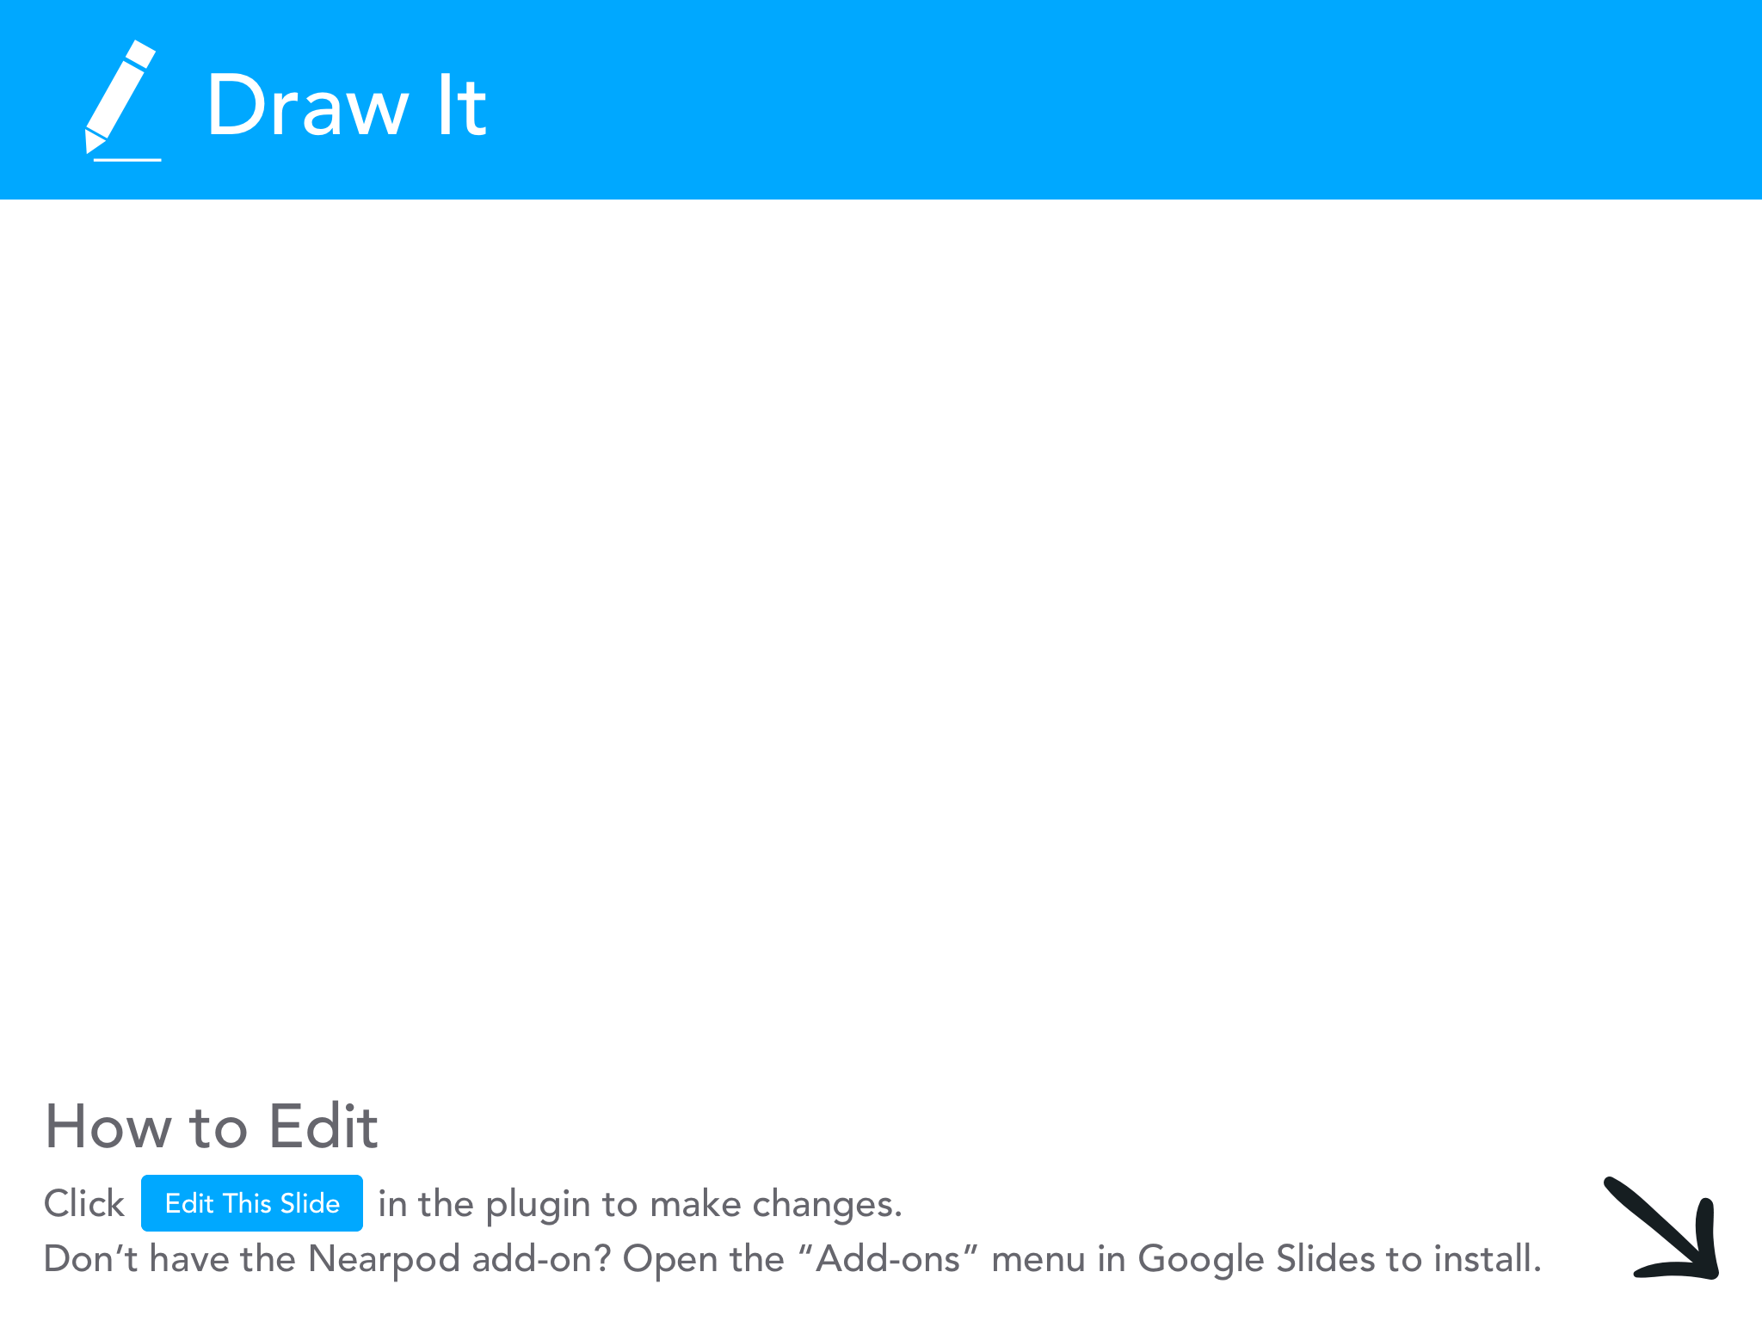
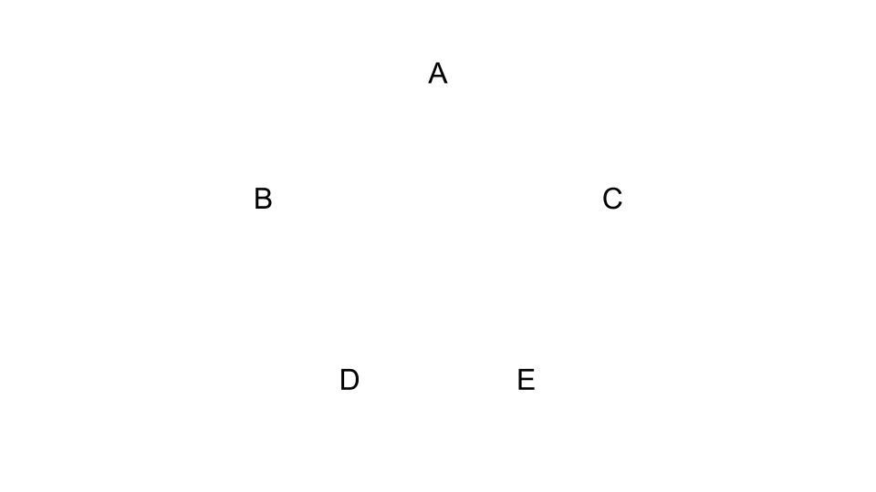

Slide 6
Network Guidelines
Guideline #1: Connections cost money, so try to use the least number of connections possible
NOTE: Individuals can pass on information if it comes in one connection and needs to go out another.

Slide 8
Network Guidelines
Guideline #1: Connections cost money, so try to use the least number of connections possible
Guideline #2: Connections can be cut, which might disconnect people from the network

Slide 10
Network Guidelines
Guideline #1: Connections cost money, so try to use the least number of connections possible
Guideline #2: Connections can be cut, which might disconnect people from the network
Guidelines #3: Direct connections are faster than long paths with indirect connections

Slide 12
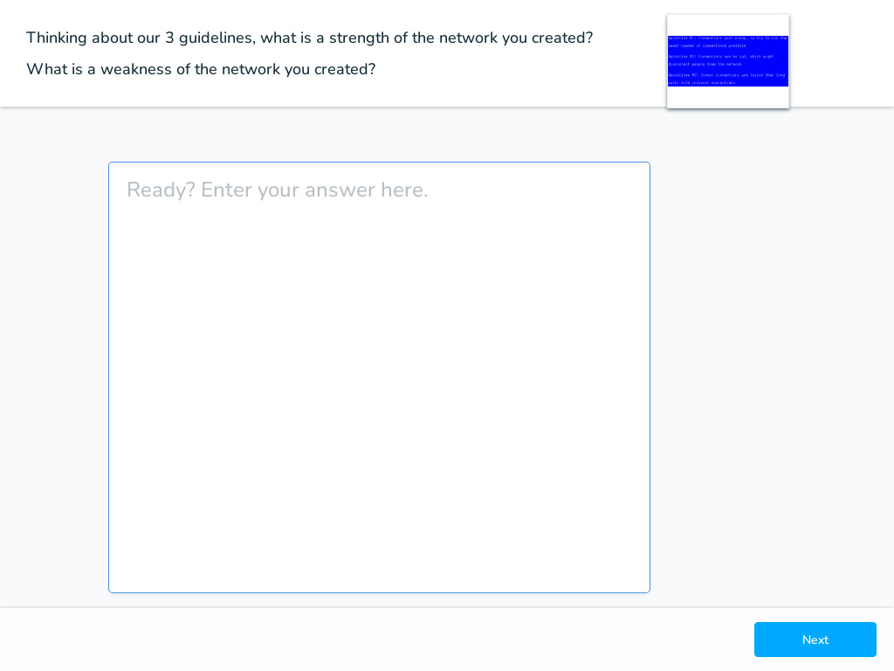

Slide 13
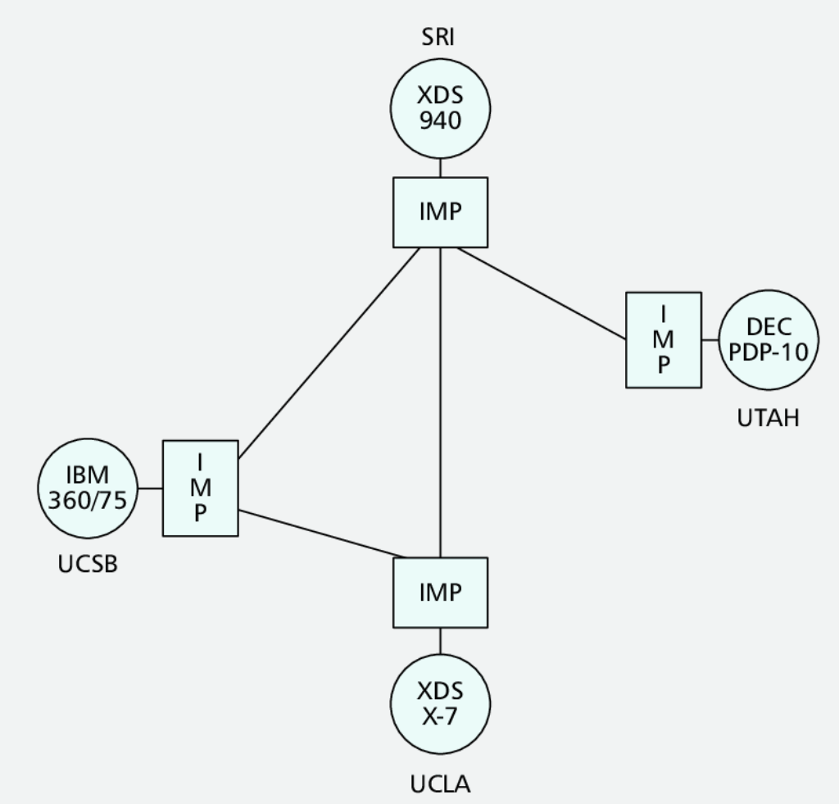
The original Internet (ARPANET)
Way back when the first Internet was created as the Advanced Research Projects Agency Network by the Defense Department in 1969. The initial ARPANET configuration linked the University of California Los Angles, Augmentation Research Center at Stanford Research Institute, University of California Santa Barbara, and the University of Utah School of Computing. Each school connected one mini-computer to the network by an IMP (Interface Message Processor, an early router).

Slide 14
The original Internet (ARPANET)
The first "successful" host-to-host connection on the ARPANET was made between Stanford Research Institute (SRI) and UCLA at 10:30 pm PST on 29 October 1969. UCLA student programmer Charley Kline typed the command "login" but initially the SDS 940 crashed after he typed two characters. So the first message sent over the internet was "lo".

Slide 15
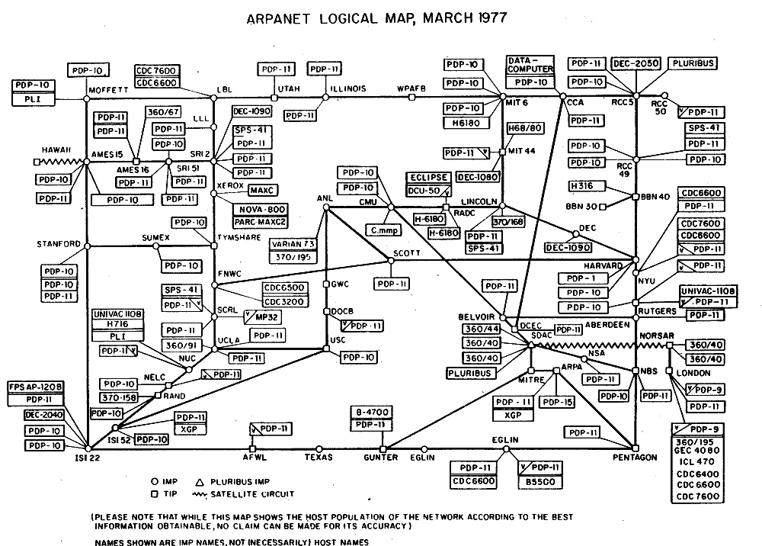
The ARPANET as of 1977.

Slide 16
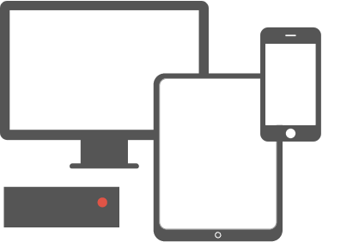
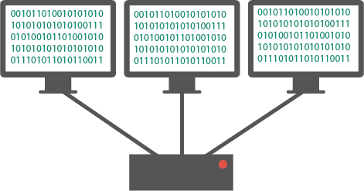
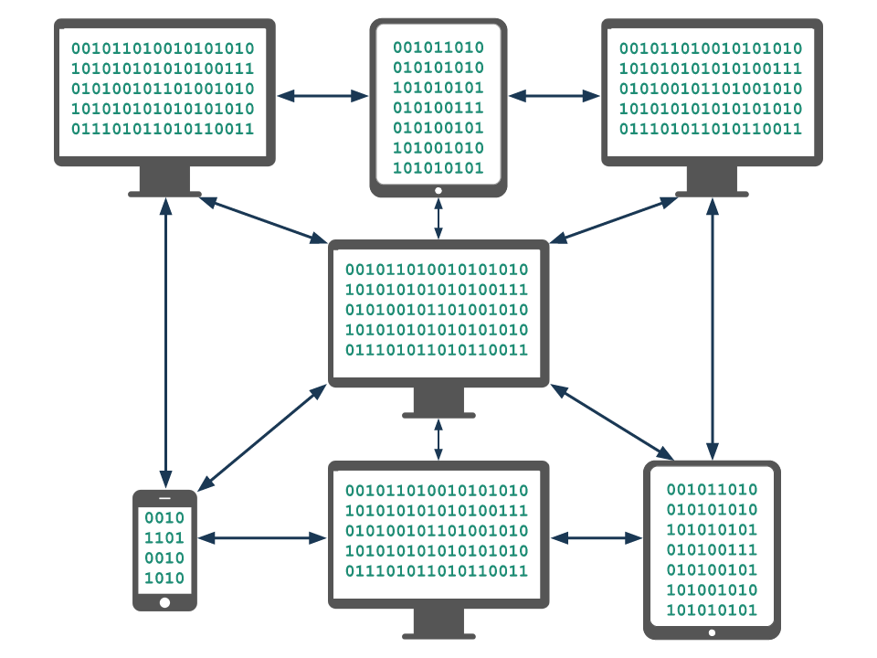
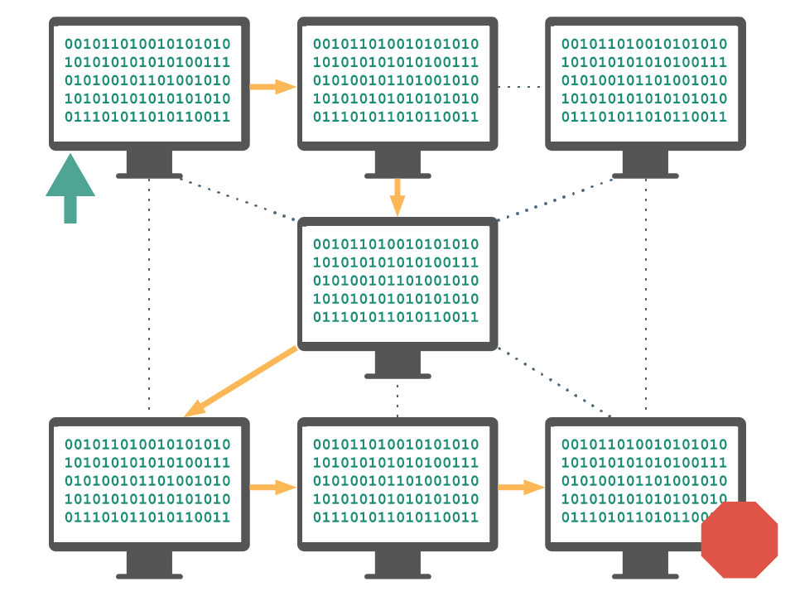
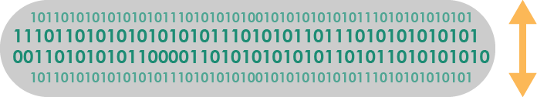
Vocabulary
Computing Device: a machine that can run a program, including computers, tablets, servers, routers, and smart sensors
Computing System: a group of computing devices and programs working together for a common purpose
Computing Network: a group of interconnected computing devices capable of sending or receiving data.
Path: the series of connections between computing devices on a network starting with a sender and ending with a receiver.
Bandwidth: the maximum amount of data that can be sent in a fixed amount of time, usually measured in bits per second.

Slide 17
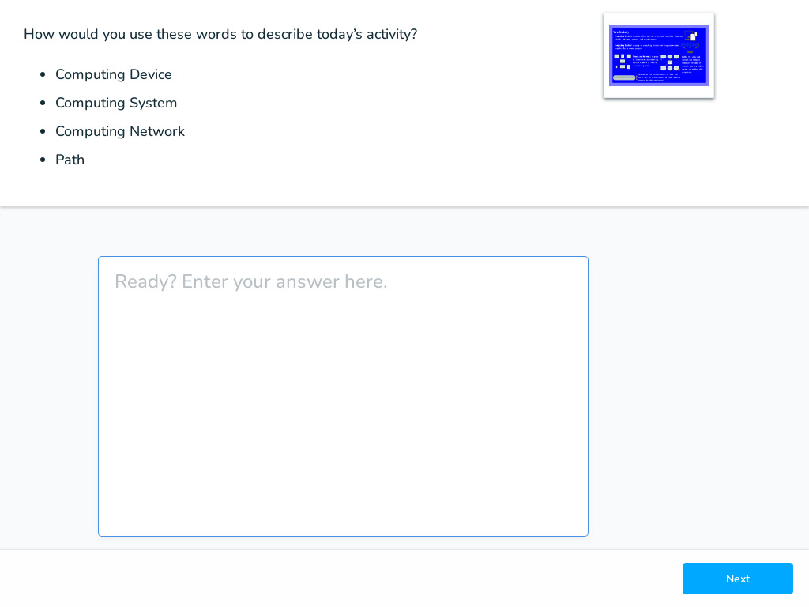

Slide 18
Quick Check
Go to code.org and answer the one question.

